Slide 1

School of Computing Science and Engineering
School of Computing Science and Engineering
Program Name: BTech , 5 SEM
Course Code : E2UC502T
Course Name : Software Testing & Quality Assurance
Module 1
Dr. Azath Hussain M.E., PhD.

Slide 2
Overview
Introduction to Software Engineering
Software crisis
Design approaches
OO Software development activities

Slide 3
School of Computing Science and Engineering
“Introduction to Software Engineering"
What is Software Engineering?
Software Engineering is the process of solving customer problems by the systematic development of producing high quality software systems within time, cost and other constraints.
To organize and control software development process and produce a well-structured, accurate and useful software solution (Objective).
Software Engineering helps us to produce a reliable software products.

Slide 4
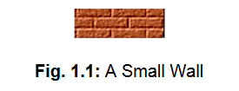
School of Computing Science and Engineering
“Introduction to Software Engineering"
Software engineering is an engineering approach for software development. We can alternatively view it as a systematic collection of past experience. The experience is arranged in the form of methodologies and guidelines.
A small program can be written without using software engineering principles. But if one wants to develop a large software product, then software engineering principles are indispensable to achieve a good quality software cost effectively. These definitions can be elaborated with the help of a building construction analogy.
Suppose you have a friend who asked you to build a small wall as shown in fig. 1.1. You would be able to do that using your common sense. You will get building materials like bricks, cement etc. and you will then build the wall.

Slide 5
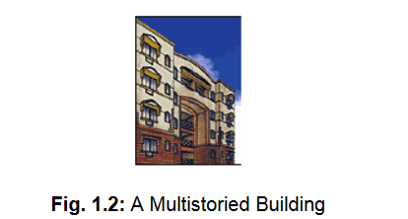
Conti…
But what would happen if the same friend asked you to build a large multistoried building as shown in fig. 1.2?
You don't have a very good idea about building such a huge complex. It would be very difficult to extend your idea about a small wall construction into constructing a large building.
Even if you tried to build a large building, it would collapse because you would not have the requisite knowledge about the strength of materials, testing, planning, architectural design, etc.
Building a small wall and building a large building are entirely different ball games. You can use your intuition and still be successful in building a small wall, but building a large building requires knowledge of civil, architectural and other engineering principles.

Slide 6
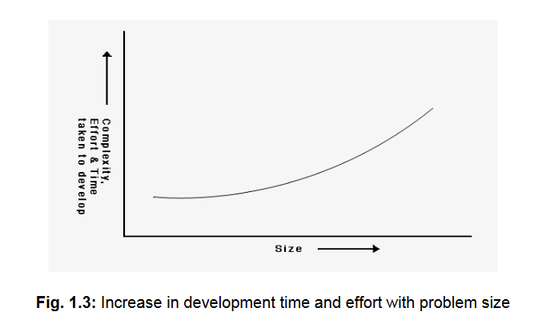
Conti..
Without using software engineering principles it would be difficult to develop large programs.
A problem with developing such large commercial programs is that the complexity and difficulty levels of the programs increase exponentially with their sizes as shown in fig. 1.3.
For example, a program of size 1,000 lines of code has some complexity.
But a program with 10,000 LOC is not just 10 times more difficult to develop, but may as well turn out to be 100 times more difficult unless software engineering principles are used.
In such situations software engineering techniques come to rescue. Software engineering helps to reduce the programming complexity.

Slide 7
Conti..
Software engineering principles use two important techniques to reduce problem complexity: abstraction and decomposition.
Abstraction is the process of removing unnecessary detail and focusing on the overview – this allows programs to run faster and use less memory.
Decomposition is the process of breaking large, complex problems into smaller, manageable parts.

Slide 8
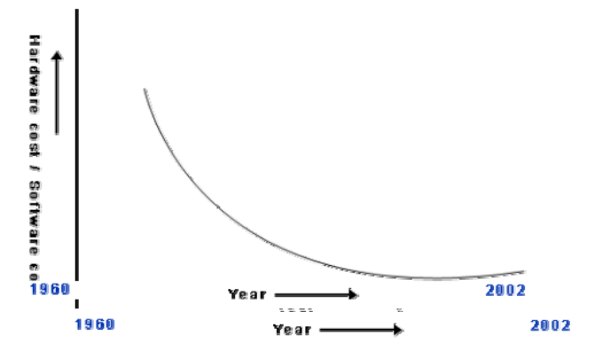
Causes of and solutions for software crisis
Software engineering appears to be among the few options available to tackle the present software crisis. To explain the present software crisis in simple words, consider the following. The expenses that organizations all around the world are incurring on software purchases compared to those on hardware purchases have been showing a worrying trend over the years (as shown in fig. 1.4 )
Figure 1.4 : Change in the relative cost of hardware and software over time

Slide 9
Software Crisis
Software development projects were delivered late.
Project running over budget.
Software was inefficient.
Software was full of errors.
Software did not satisfy requirements.
Software was difficult to maintain.

Slide 10
Conti..
Software crisis started in the mid of late 1960s and the early 1970s.
The fields of computing have become complex and diverse in the modern information society.
The main focus of practitioners from the computing outset was to provide solutions to the complexity barriers of producing software, escalating software industry and the number of software users. Thus, software came into existence.
Nowadays, every small and large scale software development company is following the engineering disciplines for developing software.

Slide 11
Conti..
The importance of software is developed due to several reasons:
1. The dependency of business organizations on software and technology has increased. Small and large scale organizations have automated their business processes for increased ease and effectiveness.
2. The varying nature and skills of users and customers have widely increased on information society. It is observed that most of the projects were unsuccessful due to unclear requirements provided from the customer.
3. The dynamic nature of software technology forces software companies to move towards component-based development, where components are assembled rather than developed from scratch.
4. Software allows changes in requirements at any stage in the development process but at maintenance stage it becomes tedious.

Slide 12
Conti..
The ultimate goal of Software practitioners is to produce faster, better and cost-effective products. Hence, systematic approaches are needed for the development, management, retirement, and improvement.
Software crisis, the symptoms of the problem of engineering the software, began to enforce the practitioners to look into more disciplined software engineering approaches for software development.
The modern software crisis has some notable symptoms, which are complexity, hardware versus software cost, lateness, costliness, poor quality, unmanageable nature, immaturity, lack of planning and management practices etc.

Slide 13
Conti..
An important cause of software crisis is the complexity of software development process.
As programs became more complex, earlier methodologies of software development were no longer useful for larger and complex projects.
Designing software is a labour-intensive task; hence, with a growing economy, more wages are to be paid.
Development, maintenance, change and reengineering processes require logical thinking and labour work. Ultimately the cost of software is higher than the hardware cost.
The time required to develop software and its cost began to exceed all estimates. It is common for the system to cost more than what had been estimated at the time of project planning (lateness, costness).

Slide 14
Conti..
Software must be of high quality with respect to product operation, product transition and product migration.
The programmers productivity must be increased.(quality)
In early days of development, change in software is a major problem for software practitioners and it makes around 40% of the total development cost.
After changing a code, the entire software or subsystem needs to be tested for reliable functioning of the system. Therefore, some systematic engineering approaches are needed for maintenance and changes.
In the modern heterogeneous development of software, different people are involved in the project. The project must be planned with the expected requirement of resources (hardware, software, people etc.), cost, time and effort.
Software crisis has inspired people to improve the processes. IT practitioners always try to follow some formal process that can help them to produce quality products, reduce cost, and improve team communication & morale.

Slide 15
Conti..
There are several such problems in the software industry.
Software products become costly, are delivered late, are unmanaged, have poor quality, decrease the productivity of programmers, increase the maintenance cost and rework, and lack of nature software processes in a complex project.
The solution to these software crises is to introduce systematic software engineering practices for systematic software development, maintenance, operation, retirement, planning and management of software.

Slide 16
Software Crisis 1.0
The term software was first coined in 1958 (www.maa.org/mathland/mathtrek_7_31_00.html), but within 10 years, problems in software’s development and delivery led to the phrase software crisis (P. Naur and B. Randell, eds., “Software Engineering: A Report on a Conference Sponsored by the NATO Science Committee,” NATO, 1968).
Over the years, several studies have confirmed Software Crisis 1.0.
Per Flatten and colleagues estimated the average project’s development time at 18 months (Foundations of Business Systems, Dryden Press, 1989)—a conservative figure, given that other estimates put the figure at three years (“The Software Trap: Automate—or Else,” Business Week, 9 May 1988, pp. 142-154) and even up to five years (T. Taylor and T. Standish, “Initial Thoughts on Rapid Prototyping Techniques,” ACM SIGSOFT Software Eng. Notes, vol. 7, no. 5, 1982, pp. 160-166).

Slide 17
Conti..
Perhaps this isn’t surprising, given that an IBM study estimated 68 percent of all software projects overran their schedules (P. Bowen, “Rapid Application Development: Concepts and Principles,” IBM document no. 94283UKT0829, 1994).
In relation to cost, the IBM study also suggested that development projects were as much as 65 percent over budget. Indeed, the term shelfware was coined to refer to software systems that are delivered but never used.
Although the Standish Group continues to paint a rather bleak picture of the high rates of software project failure (http://standishgroup.com/newsroom/chaos_manifesto_2011.php), its findings and methodology have been challenged (J. Eveleens and C. Verhoef, “The Rise and Fall of the CHAOS Reports,” IEEE Software, 2010, pp. 30-36).
In fact, I (Author :Brian Fitzgerald/Software Crisis 2.0/IEEE/0018-9162/12) believe that Software Crisis 1.0 has passed, and that the myriad, incremental advances pushing software development forward have changed our lives for the better.
Changes in the practice have ultimately led the field to the point where software is now routinely developed largely on time, within budget, and meeting user expectations.

Slide 18
Conti..
Organizations are spending larger and larger portions of their budget on software.
Not only the software products turning out to be more expensive than hardware, but they also present a host of other problems to the customers: software products are difficult to alter, debug, and enhance; use resources non-optimally; often fail to meet the user requirements; are far from being reliable; frequently crash; and are often delivered late.
Among these, the trend of increasing software costs is probably the most important symptom of the present software crisis. Remember that the cost we are talking of here is not on account of increased features, but due to ineffective development of the product characterized by inefficient resource usage, and time and cost over-runs.
There are many factors that have contributed to the making of the present software crisis. Factors are larger problem sizes, lack of adequate training in software engineering, increasing skill shortage, and low productivity improvements.
It is believed that the only satisfactory solution to the present software crisis can possibly come from a spread of software engineering practices among the engineers, coupled with further advancements to the software engineering discipline itself.

Slide 19
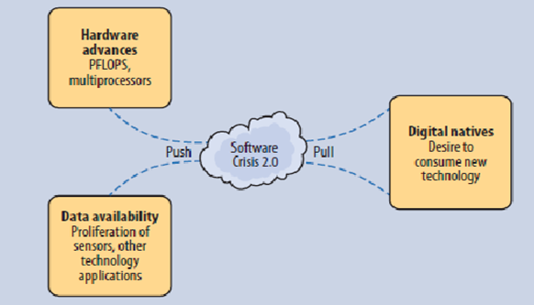
Software Crisis 2.0
Unfortunately, Software Crisis 2.0 is now looming. As Figure 1.5 shows, this crisis stems from the inability to produce software that can leverage the staggering increase in data generated in the past 50 years and the demands of the devices and users that can manipulate it.
The demand for data from digital natives, coupled with the huge volume of data now generated through ubiquitous mobile devices, servers, and applications, has led to a new software crisis.
Figure 1.5 : Software Crisis 2.0

Slide 20
Software Engineering Challenges
Software Engineering is facing a number of software problems since software crisis. The primary focus of software companies is to produce quality software within budget and small cycle time. These software challenges reflect the development and maintenance of software is an important issue or practitioners.
1. Problem Understanding:
Customers are from different backgrounds and they do not have a clear understanding of their problems and requirements. Also, the customers don’t have technical knowledge, especially those who are living in remote areas.
Similarly software engineers do not have the knowledge of all application domains and detailed requirements of the problems and the expectations of the customer. The lack of communication among software engineers and customers causes problems for the software engineers in clearly understanding the customer needs. There are many people involved in an organization. Therefore, it becomes difficult to find requirements from different perspectives and customers. Sometimes the customers do not have sufficient time to explain their problems to the development organization.

Slide 21
Conti..
2. Quality and Productivity:
Software Engineering practices mainly emphasize providing quality products in a small cycle time.
Quality products provide customer satisfaction.
A good quality product implements features that are required by the customer that have certain quality attributes such as reliability, usability, efficiency, maintainability, portability, and functionality.
Production of Software is measured in terms of KLOC person month (PM).
Higher productivity means that cycle time can be reduced with the low cost of the product.
The productivity and quality of Software depend on several factors, such as programmer’s ability, type of technology, level of experience, nature of projects and their complexity, available time, required resources etc.

Slide 22
Conti..
3. Cycle Time and Cost:
The customer always foresees faster and cheaper production of software products. Therefore, software companies put efforts to reduce the cycle time of product delivery and minimize the product cost.
Delivery before the calendar time sometimes compromises the product quality due to competitive reasons.
The cost of the software product is generally the cost of hardware, software and manpower resources.
It is calculated based on the no. of persons engaged in a project and for how much time.
Cost also depends on the complexity levels of the project.

Slide 23
Conti..
4. Reliability:
It is the most important quality attribute.
It is the successful operation of software within the specified environment and duration under certain constraints.
Verification and Validation techniques are used to ensure the reliability ratio in the product.
Defect detection and prevention is the prerequisite to high reliability in the product where several automated testing tools are available for its removal.
Software becomes unreliable due to logical errors present in the programs of the Software. Project complexity is the major cause of software unreliability.

Slide 24
Conti..
5. Change and Maintenance:
Change and maintenance in software come when the software is delivered and deployed at the customer site.
They occur if there is any change in the business operation, errors in the software, or addition of new features.
Change in one part of the software requires change in other parts also. After any change and maintenance operation, software is rigorously tested to keep it reliable.
As change and maintenance in Software are flexible but very expensive, sometimes the maintenance and rework cost becomes more than the development cost.
The challenge is to accommodate changes under controlled cost and reliability as due to repeated maintenance and change, software deteriorates its operational life and quality.
Thus, to accommodate increasing requirements and streamline the modern technology, software is needed to be reengineered onto a modern platform.

Slide 25
Conti..
6. Usability and Reusability:
Usability means the ease of use of a product in terms of efficiency, effectiveness and customer satisfaction.
Software Engineering has always concentrated on providing a usable product by incorporating customer suggestions and technological issues.
There are many products which came into existence but became unsuccessful due to certain software design and usability issues.
Reuse of existing software components and their development has become institutional business in the modern software business scenario.
The analysis of domain knowledge, development of reusable library, and integration of reusable components in software development are some important issues in reuse-based development.
Reusability increases reliability because reusable components are well tested before integrating them into software development.

Slide 26
Conti..
7. Repeatability and Process Maturity:
Software development processes are procedural rules to adhere to when developing software.
A Software engineering process can be repeated in similar projects, which improves productivity and quality.
Repeatability can help to plan project schedule, fix deadlines for product delivery, manage configuration, and identify locations of bug occurrences.
Repeatability promotes process maturity.
A Mature software process produces quality products and improves software productivity.
There are several standards, such as Capability Maturity Model (CMM), ISO and six sigma, which emphasize process maturity and its guidelines.

Slide 27
Conti..
8. Estimation and Planning:
Present estimation methods, such as Lines of Code (LOC), Function Point (FP), and Object Point (OP), are sometimes unable to accurately estimate project efforts.
Most of the projects fail due to underestimation of budget and time to complete the project.
The effectiveness of the project plan depends on the accuracy of the estimation and understanding of the problem.
The use of an effective project planning and estimation technique is an important challenge for the practitioners.
The rest of the project’s activities depend on estimation and planning.

Slide 28
System and roles
System
A collection of interconnected parts
Model any abstraction of the system
Roles
Client – high level requirements, scope, deadline, budget, quality criteria
User – domain knowledge
Manager – progress evaluation, resource managing
Developers – construction (analyzing, designing, implementing, and testing)
Technical writer - documentation

Slide 29
School of Computing Science and Engineering
“Software Development Techniques"
Software Development Techniques
Successful projects are managed well. To manage a project efficiently, the manager or development team must choose the software development methodology that will work best for the project at hand. All methodologies have different strengths and weaknesses and exist for different reasons.
Agile development methodology
DevOps deployment methodology
Waterfall development method
Rapid application development
Prototyping Model
Spiral Model

Slide 30
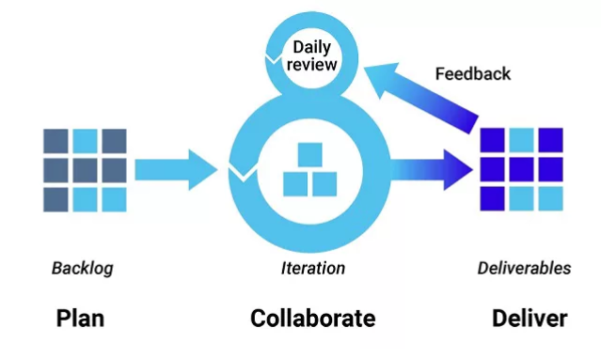
School of Computing Science and Engineering
“Software Development Techniques"
Agile Development Methodology
Teams use the agile development methodology to minimize risk (such as bugs, cost overruns, and changing requirements) when adding new functionality. In all agile methods, teams develop the software in iterations that contain mini-increments of the new functionality. There are many different forms of the agile development method, including scrum, crystal, extreme programming (XP), and feature-driven development (FDD).

Slide 31
School of Computing Science and Engineering
“Software Development Techniques"
Pros:
The primary benefit of agile software development is that it allows software to be released in iterations. Iterative releases improve efficiency by allowing teams to find and fix defects and align expectation early on. They also allow users to realize software benefits earlier, with frequent incremental improvements.
Cons:
Agile development methods rely on real-time communication, so new users often lack the documentation they need to get up to speed. They require a huge time commitment from users and are labor intensive because developers must fully complete each feature within each iteration for user approval.
Agile development methods are similar to rapid application development (see below) and can be inefficient in large organizations. Programmers, managers, and organizations accustomed to the waterfall method (see below) may have difficulty adjusting to an agile SDLC. So a hybrid approach often works well for them.

Slide 32
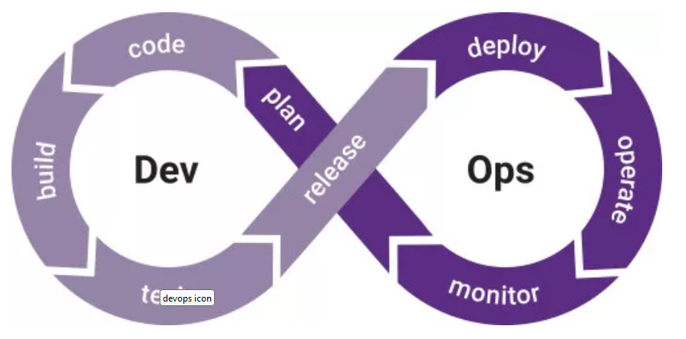
School of Computing Science and Engineering
“Software Development Techniques"
DevOps Deployment Methodology
DevOps (Development & Operations) is not just a development methodology but also a set of practices that supports an organizational culture.
DevOps deployment centers on organizational change that enhances collaboration between the departments responsible for different segments of the development life cycle, such as development, quality assurance, and operations.

Slide 33
School of Computing Science and Engineering
“Software Development Techniques"
Pros:
DevOps is focused on improving time to market, lowering the failure rate of new releases, shortening the lead time between fixes, and minimizing disruption while maximizing reliability.
To achieve this, DevOps organizations aim to automate continuous deployment to ensure everything happens smoothly and reliably.
Companies that use DevOps methods benefit by significantly reducing time to market and improving customer satisfaction, product quality, and employee productivity and efficiency.
Cons:
Even in light of its benefits, there are a few drawbacks to DevOps:
Some customers don’t want continuous updates to their systems.
Some industries have regulations that require extensive testing before a project can move to the operations phase.
If different departments use different environments, undetected issues can slip into production.
Some quality attributes require human interaction, which slows down the delivery pipeline.

Slide 34
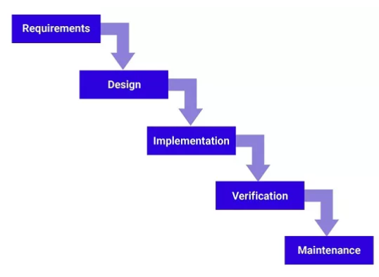
School of Computing Science and Engineering
“Software Development Techniques"
Waterfall Development Method
Many consider the waterfall method to be the most traditional software development method. The waterfall method is a rigid linear model that consists of sequential phases (requirements, design, implementation, verification, maintenance) focusing on distinct goals.
Each phase must be 100% complete before the next phase can start. There’s usually no process for going back to modify the project or direction.

Slide 35
School of Computing Science and Engineering
“Software Development Techniques"
Pros:
The linear nature of the waterfall development method makes it easy to understand and manage. Projects with clear objectives and stable requirements can best use the waterfall method. Less experienced project managers and project teams, as well as teams whose composition changes frequently, may benefit the most from using the waterfall development methodology.
Cons:
The waterfall development method is often slow and costly due to its rigid structure and tight controls. These drawbacks can lead waterfall method users to explore other software development methodologies.

Slide 36
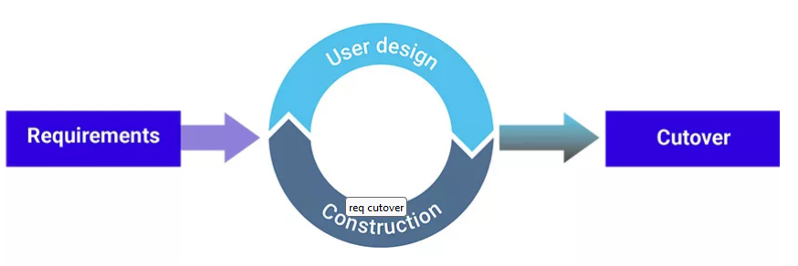
School of Computing Science and Engineering
“Software Development Techniques"
Rapid Application Development
Rapid Application Development (RAD) is a condensed development process that produces a high-quality system with low investment costs. Scott Stiner, CEO and president of UM Technologies, said in Forbes, “This RAD process allows our developers to quickly adjust to shifting requirements in a fast-paced and constantly changing market.” The ability to quickly adjust is what allows such a low investment cost.
The rapid application development method contains four phases: requirements planning, user design, construction, and cutover. The user design and construction phases repeat until the user confirms that the product meets all requirements.

Slide 37
School of Computing Science and Engineering
“Software Development Techniques"
Pros:
Rapid application development is most effective for projects with a well-defined business objective and a clearly defined user group, but which are not computationally complex.
RAD is especially useful for small to medium projects that are time sensitive.
Cons:
Rapid application development requires a stable team composition with highly skilled developers and users who are deeply knowledgeable about the application area.
Deep knowledge is essential in a condensed development timeline that requires approval after each construction phase.
Organizations that don’t meet these requirements are unlikely to benefit from RAD.

Slide 38
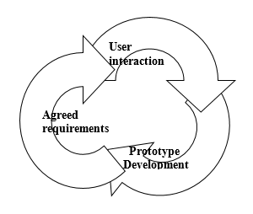
School of Computing Science and Engineering
“Software Development Techniques"
Prototyping Model
To overcome the first limitations of the water-fall model prototyping model is introduced which is also called as throw away prototyping.
Step-1: the project should start with the minimum requirements of the user.
Step-2: based on the minimum requirements developer develops a prototype model.
Step-3: while preparing the prototype model it contains following phases:
Analysis
Design
Coding
Testing
Step-4: the user feels that as if he is using the complete project but it is just a model.
Step-5: The prototype is given to the user to play with it and the user will end Intangible values.

Slide 39
School of Computing Science and Engineering
“Software Development Techniques"
Prototyping Model
Step-6: during this phase, the developer will understand the rest of the requirements
Step-7: the same process will continue until the user satisfies
Step-8: Once the developer knows all the requirements the prototype will be thrown away
Step-9: used for large and complex projects.
Pros:
We can reduce the cost.

Slide 40
School of Computing Science and Engineering
“Software Development Techniques"
Spiral Model
Spiral model is a combination of water-fall model and prototyping and risk analysis factor. Unlike water-fall it is not linear it is spiral .which is also known as Cartesian model which is divided into four quadrants.
The first quadrant deals with risk analysis to be identified.
The second deals with the phases where the risk is going to be occurred.
The third quadrant deals with the eliminations or removal of risk with a particular plan.
The fourth quadrant deals with the review of the particular phase.
The activities in this spiral model are organized as a spirals which consists of several cycles.

Slide 41
School of Computing Science and Engineering
“Software Development Techniques"
Spiral Model
The activities that are carried out in this spirals are :
Risk analysis
Software requirement
Software product design
Design validation and verifications
Requirement validations
Testing with all its types
Review
Development plan

Slide 42
School of Computing Science and Engineering
“Software Development Techniques"
Spiral Model
If the review is yes i.e., is obtained for a prototype then it goes to the next phase otherwise it works in the same phase.
Verification: it deals with process whether the process is going in right way or not.
Validation: it deals with the product it gives the output.
If the risk is identified then this will be overcome by design verification and validation and goes to the review .if the output exist it goes to next phases otherwise work in the same phase.
Radius of the spiral explains about cost of the project.
Angular of the spiral explains about the progress of the project.

